Slide 1
OSHA Recordkeeping
Scott Cole, CSP, SMS, CHST
colesafetyservices@yahoo.com
216.318.3878

Slide 2
Agenda
Review of Recordkeeping Forms
Defining an OSHA Recordable
Questions

Slide 3
Recordkeeping Requirements
OSHA requires facilities to maintain records of all serious work-related injuries and illnesses (Recordables)
Applies to Employers with 10 or more employees
  https://www.osha.gov/recordkeeping/presentations/exempttable
The employer has the ultimate responsibility for making a good faith determination about recordability

Slide 4
Recordkeeping Requirements
Establishments that meet certain size (250+) and industry criteria are required to submit injury and illness data
  Injury Tracking Application (ITA).
  Manually enter data annually
Severe Injury Reporting
  Employers must report any worker fatality within 8 hours and any amputation, loss of an eye, or hospitalization of a worker with 24 hours
    Report online or by phone

Slide 5
Recordkeeping Requirements
NEW
Effective January 1, 2024
  Establishments with 100 or more employees in certain high-hazard industries must electronically submit recordkeeping information
    https://www.osha.gov/sites/default/files/appendix_b_to_subpart_e_of_part_1904.pdf
  OSHA will publish some of the data collected on its website to Allow employers, employees, potential employees, etc. to use information about a company’s safety performance to make informed decisions

Slide 6
Recordkeeping Forms
OSHA Form 300
  Log of Work-Related Injuries and Illnesses
OSHA Form 301
  Injury and Illness Incident Report
OSHA Form 300A
  Summary of Work-Related Injuries and Illnesses
    Post February 1 – April 30
    Submit to ITA (Injury Tracking Application) by March 2
PERRP Forms
  300P, 301P, 300AP
https://www.osha.gov/recordkeeping/forms

Slide 7


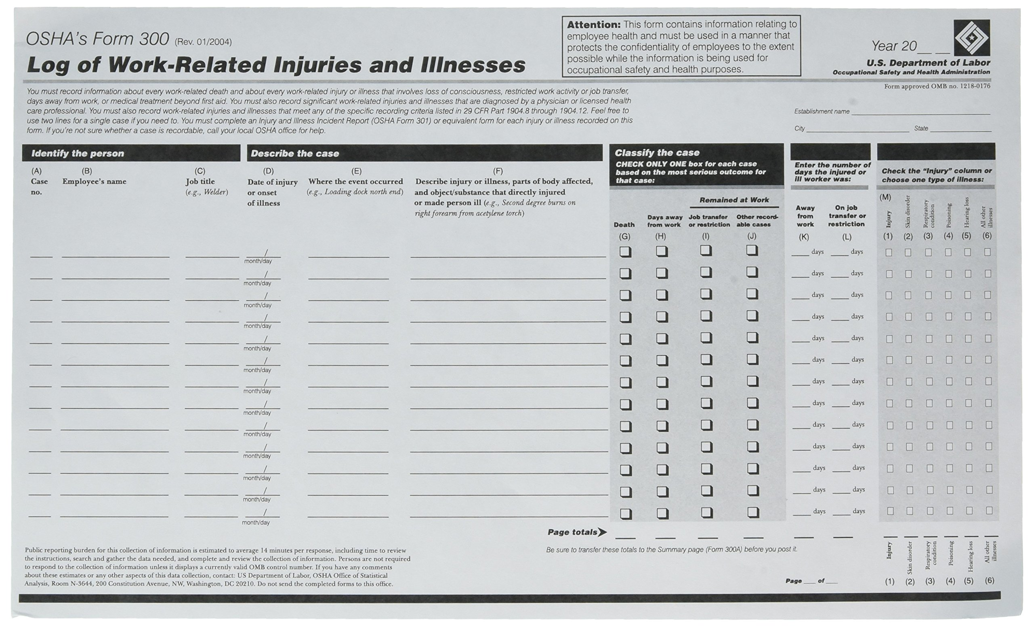
OSHA Form 300

Slide 8
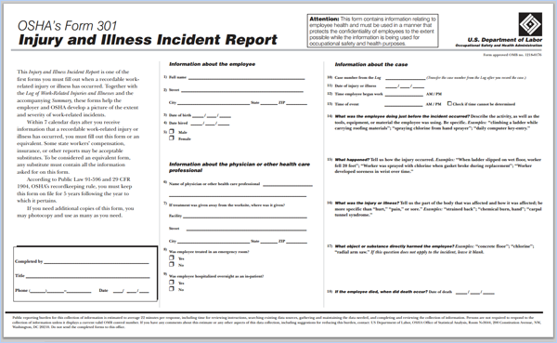
OSHA Form 301

Slide 9
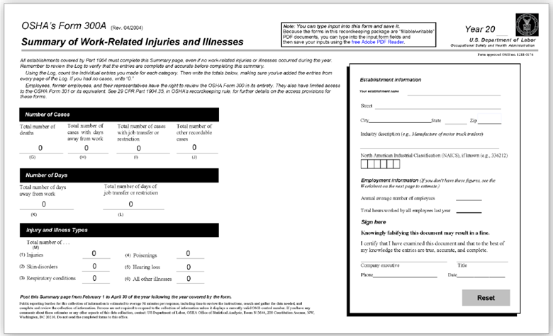
OSHA Form 300A

Slide 10
Recordability vs Compensability
The requirements for recordability should not be confused with compensability
Decisions regarding recordability must be made without regard to compensability

Slide 11
Recordkeeping Criteria
Employers must record each fatality, injury, or illness that is:
  work-related; and
  a new case; and
  meets one or more of the general recording criteria contained in sections 1904.7-1904.12

Slide 13
Establishing Work Relationship
If an event results in an injury/illness in the work environment, it is presumed work-related
  A case is considered work-related if an event or exposure in the work environment either caused or contributed to the resulting condition
  A pre-existing injury or illness is considered work-related if an event or exposure in the work environment SIGNIFICANTLY aggravated the condition

Slide 14
Establishing Work Relationship CONT.
pre-existing injury or illness is significantly aggravated when an event or exposure in the work environment results in any of the following:
  death
  loss of consciousness
  one or more days away from work, or restricted days, or a job transfer
  medical treatment

Slide 15
Work Relationship Exceptions
Employee present as a member of the general public (rather than employee)
Symptoms surface at work solely due to non-work related event
Voluntary participation in wellness programs, medical, fitness, or recreational activity
Eating, drinking, or preparing food or drink for personal consumption

Slide 16
Work Relationship Exceptions CONT.
Personal tasks outside assigned working hours
Personal grooming, self-medication for a non-work related condition, or intentionally self-inflicted
Motor vehicle accident in company parking lot / access road during commutes

Slide 17
Work Relationship Exceptions CONT.
The illness is the common cold or flu
Note: contagious diseases such as COVID-19, tuberculosis, brucellosis, hepatitis A, or plague are considered work-related if the employee is infected at work

Slide 18
COVID-19
COVID-19 can be a recordable illness if a worker is infected as a result of performing their work-related duties. However, employers are only responsible for recording cases of COVID-19 if all of the following are true:
  The case is a confirmed case of COVID-19;
  The case is work-related; and
  The case involves one or more of the general recording criteria set forth in 29 CFR 1904.7
    (e.g., medical treatment beyond first aid, days away from work)

Slide 19
Work From Home
Work-related if the injury or illness occurs while the employee is performing work for pay or compensation in the home, and the injury or illness is directly related to the performance of work rather than to the general home environment or setting

Slide 20
First Aid Incident
defined as anything contained in a comprehensive, specific list within the Recordkeeping standard
This is a complete list of all treatments considered first aid
First aid can be administered by a physician, nurse, or other licensed health care professional
First Aid cases are not recordable

Slide 21
First Aid IncidentS
Non prescription medication at non- prescription strength
Tetanus immunizations
Cleaning, flushing, soaking surface wounds
Wound coverings, butterfly bandages, steri-strips
Hot or cold therapy (regardless of number of applications)

Slide 22
First Aid IncidentS
Non-rigid means of support, e.g., ace bandage
Temporary immobilization devices used to transport accident victims
Drilling, toe or finger nails, draining fluid from blister
Eye patches
Massages (not physical therapy)

Slide 23
First Aid IncidentS
Removing foreign bodies from eye with only irrigation or cotton swab
Removing splinters/foreign material from areas other than eye by irrigation, tweezers, cotton swabs or other simple means
Finger guards
Drinking fluids to relieve heat stress

Slide 24
First Aid IncidentS
If not included on the first aid list, the treatment is RECORDABLE

Slide 25
Recordable Incident
a case is recordable if the injury or illness results in:
  death
  days away from work
  restricted work or transfer to another job
  medical treatment beyond first aid
  loss of consciousness

Slide 26
Recordable Incident CONT.
  Record a case if it involves a significant injury or illness, diagnosed by a licensed health care professional, even if it does not result in death, days away from work, restricted work or job transfer, medical treatment beyond first aid, or loss of consciousness
  Examples include:
    punctured eardrum
    fracture
    chronic irreversible disease

Slide 27
! Warning !
The following slides contain pictures of an actual injury

Slide 28
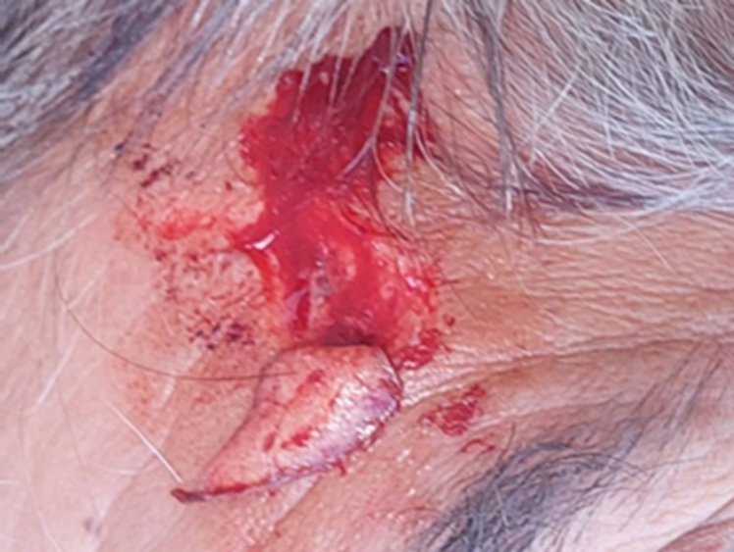

Slide 29
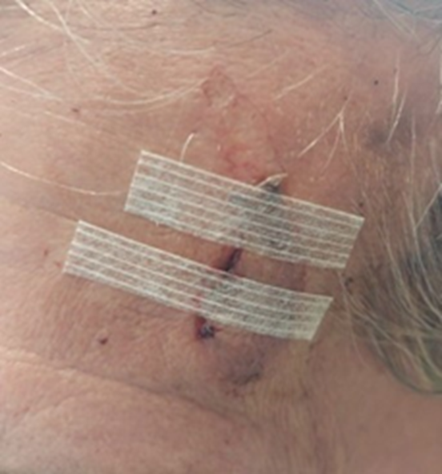

Slide 30
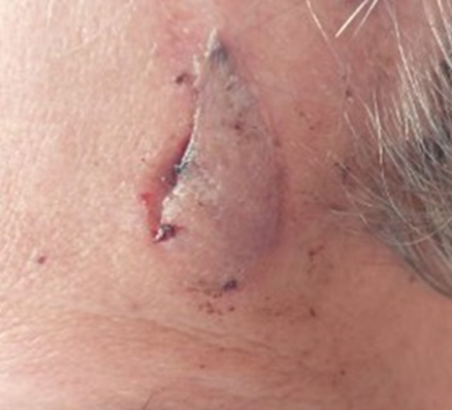

Slide 31
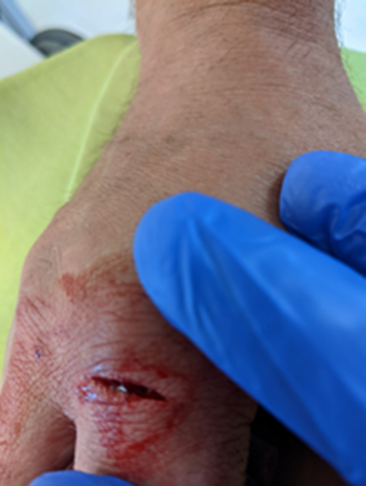

Slide 32
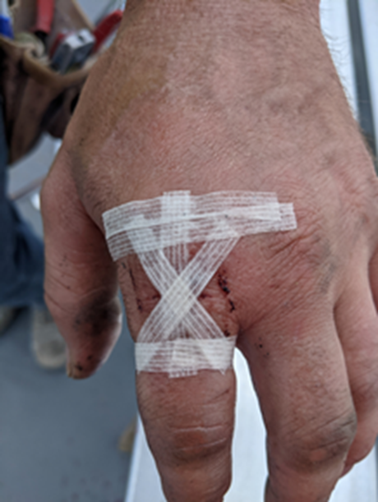

Slide 33
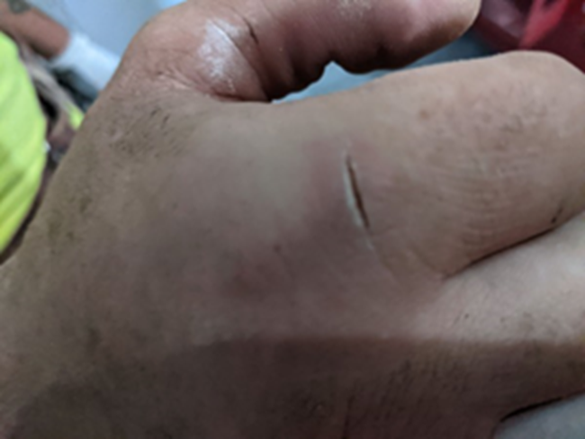

Slide 34
Medication
Issuance of any prescription medication (including single dose) is recordable. Even if:
  the employee does not take the prescription, or
  the employee does not fill it
Over the counter medication, e.g., ibuprofen, given in prescription strength is recordable
Samples of prescription medicine are recordable

Slide 35
Hearing Loss
Hearing loss cases are recordable if there is a work-related shift in hearing of an average of 10 dB or more at 2,000, 3,000, and 4,000 Hz in one or both ears

Slide 36
Burns
Only burns that receive medical treatment are recordable Therefore:
  the vast majority of 1st degree burns and minor second degree burns will not be recordable
  more serious 1st and 2nd degree burns that receive medical treatment will be recordable
  3rd degree burns are recordable

Slide 37
Travel Status
To be on travel status, employees must either be:
  outside their normal geographic area of operation, or
  working off premises for more than a normal workday (such as staying overnight)
An employee's "normal geographic area of operation" includes the town or city where the employee normally works and directly adjoining municipalities

Slide 38
Travel Status
When a traveling employee checks into a hotel or motel, they establish a "home away from home"
An injury/illness would not be recordable if it occurred during normal living activities, e.g., eating, sleeping, recreation, etc., or if the employee deviates from a reasonably direct route of travel

Slide 39
Travel Status
Employees who travel on company business shall be considered to be engaged in work-related activities all the time they spend in the interest of the company, including, but not limited to, travel to and from customer contacts and, entertaining for the purpose of transacting, discussing, or promoting business

Slide 40
Lost Workdays
  Lost workday cases are those cases resulting in days lost from work of injury or illness
  The number of days away from work does not include the day of injury, or the onset of illness
  Count the number of calendar days the employee was unable to work, regardless of whether the employee was scheduled to work
  Weekend days, holidays, and vacation days, or other days off, e.g., temporary plant closing, are included in the total number of lost workdays recorded if the employee was not able to work

Slide 41
Lost Workdays
The total days away from work are “capped” at 180 calendar days
Stop counting days away from work if the employee leaves the company for some reason unrelated to the injury or illness, such as retirement, permanent plant closing, or to take another job

Slide 42
Restricted Workdays
The emphasis on determining restricted activity is the employee's ability to perform all of his or her routine functions during all of his or her normal workday or shift
An employee’s routine functions are those work activities the employee regularly performs at least once per week.
The total days are “capped” at 180 calendar days

Slide 43
Retention & Maintenance
Keep forms for the current year plus 5 previous years
Must update the OSHA Form 300 during the retention period
DO NOT need to update the OSHA Form 300A or 301

Slide 44
Thank You
Questions?
Scott Cole
216-318-3878
colesafetyservices@yahoo.com – EHS Services
Treestotreasure@yahoo.com – Wood and Wood-Related Services
www.Treestotreasure.com

Slide 45
